Slide 1
Bike Rental Demand Analysis
Isha Bardia
NextHikes IT Solutions

Slide 2
Project Overview
Analyzing bike rental data helps understand how weather, time, and holidays affect bike rentals. Data on bike rentals, weather, and user types is collected hourly and daily. Three different datasets are given in this project. This project uses excel to clean, preprocess and join data. This helps visualize trends, create new features and how time and weather will affect the rental and so on.

Slide 3
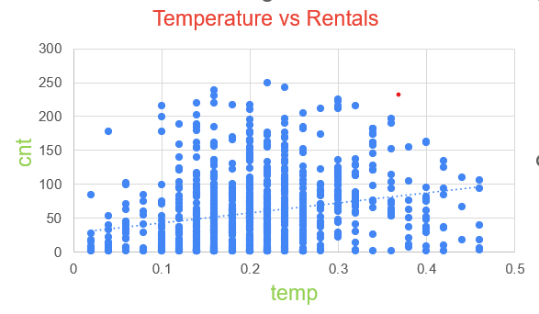
Temperature Analysis
This Scatterplot shows how temperature affect the rentals.
Plot shows that there is weak but positive correlation between temperature and rentals.
High temperature will slightly increase the rental demands.

Slide 4
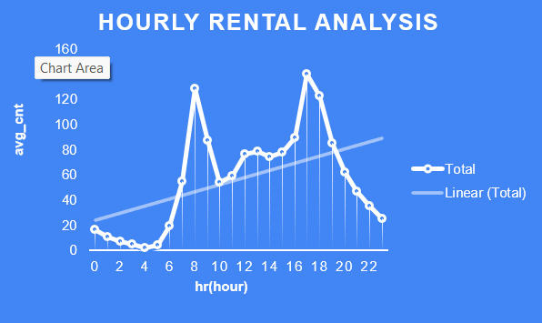
Time Analysis
Relation between time(hr) and rentals are shown using line chart.
Rental demands are at peak in morning and evening.
Bike rentals are low in early morning or late night.
Demand increases during commuting hours.

Slide 5
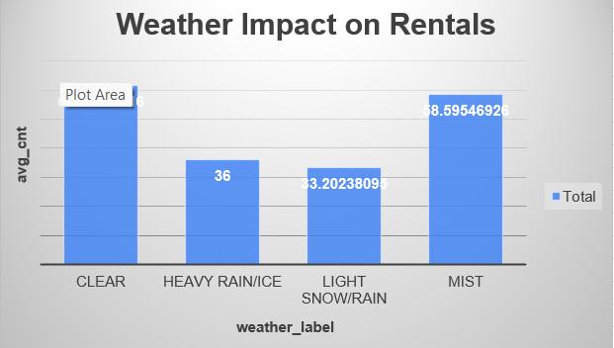
Weather Impact on Rental
Impact of weather on rentals is shown using column chart.
It shows that there is significant impact of weather on bike rantal demand.
Rental demands are high when weather is clear.
Whereas rental demands are low when weather is bad(Rain, snow,etc.)

Slide 6
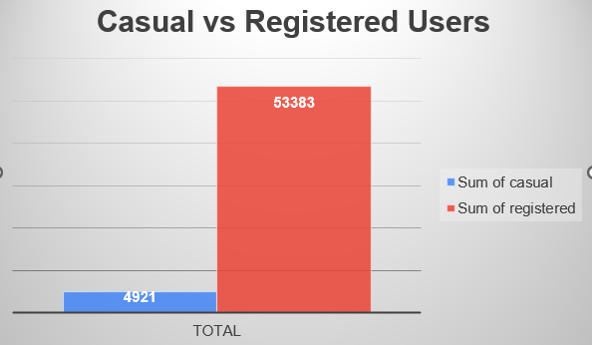
Casual vs Registered Users
There are both casual and registered user for bike rental.
Registered users contribute much more to rental demands than casual users.

Slide 7
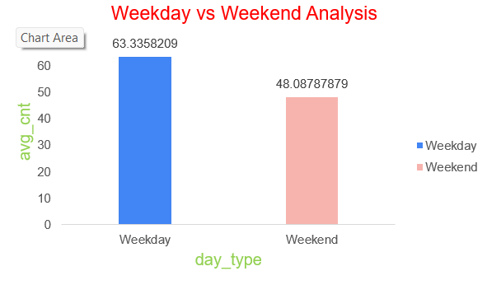
Day Analysis
Rentals demands are high on weekdays in compare to weekend.

Slide 8
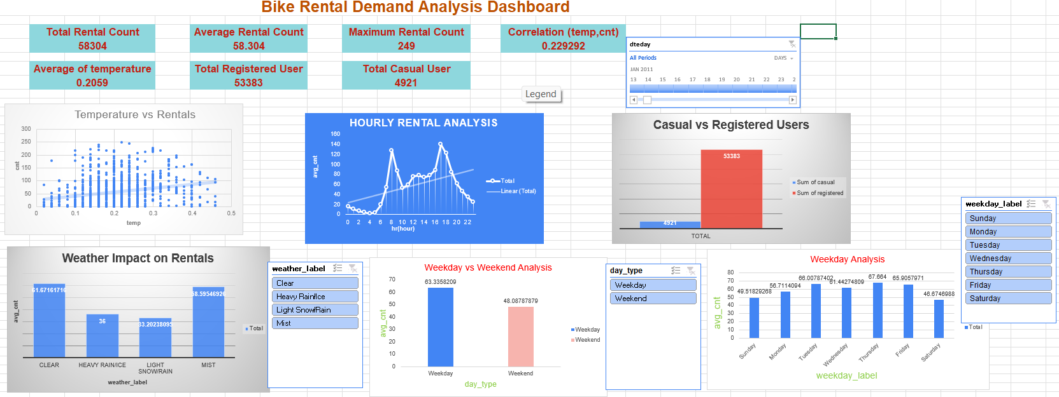
Dashboard
Rental demands increases with high temperature.
Rental demands are at peak in morning and evening.
Registered users contribute more to rental than casual users
Rentals are more when weather is clear.
Rental are low during bad weather
Rental demands are higher on weekdays in compare to weekend.
Weak positive correlation between temperature and rentals.

Slide 9
Thank You !

